Slide 1

Huynh Bao Trung Nguyen, Andreas Stiller, Luke Gavin

Slide 2
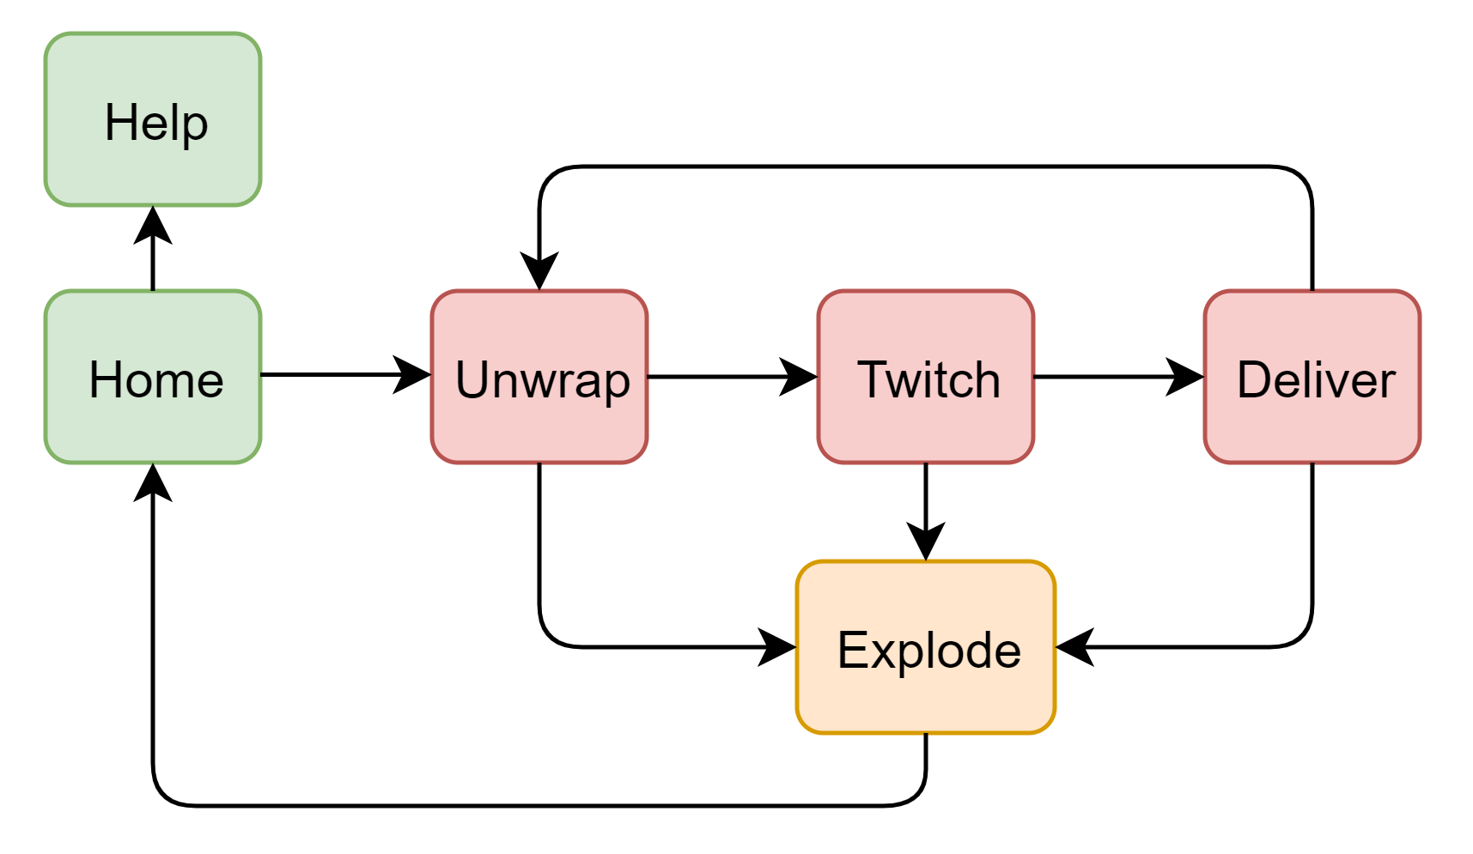
Idea & Design
„Hot Potato“-Game → Bomb-Game „WatchOut“
Players need to solve Tasks and then pass it to another Player
Bomb explodes if its stability is too low
Tasks:
Unwrap
Twitch
Deliver

Slide 3
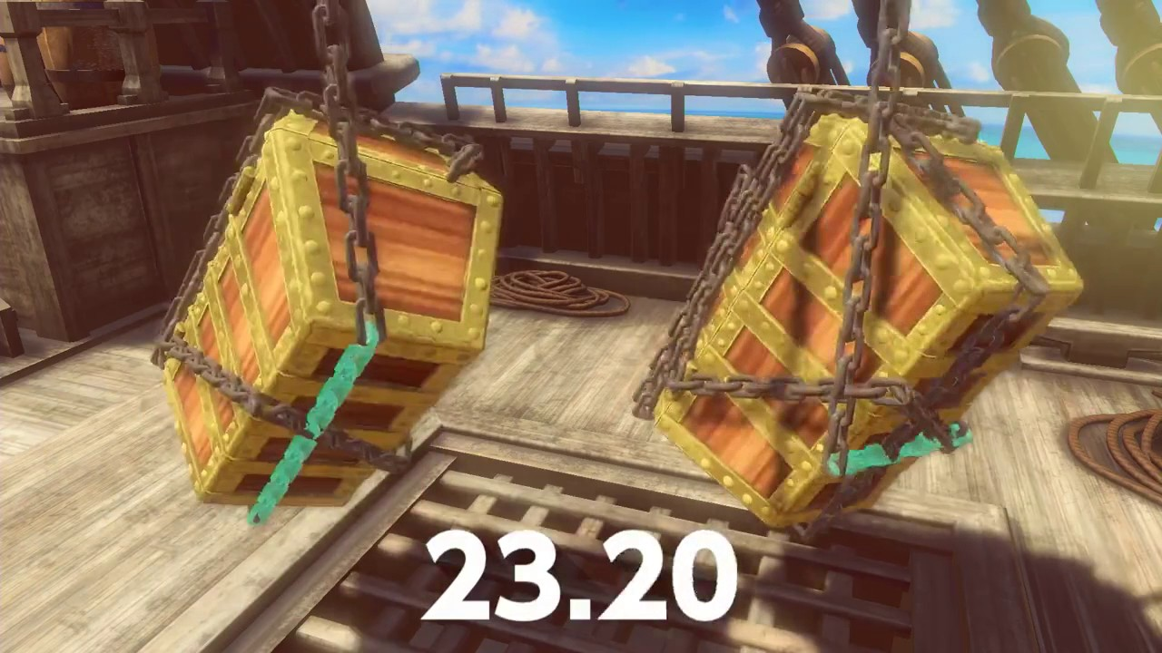
Unwrap
Unwrap in x-, y- or z-rotation

Slide 4
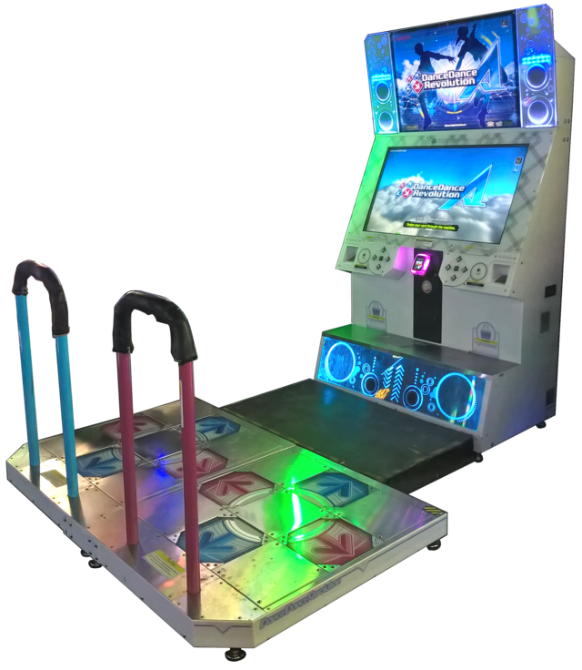
Twitch
Move the iPhone in the shown directions

Slide 5
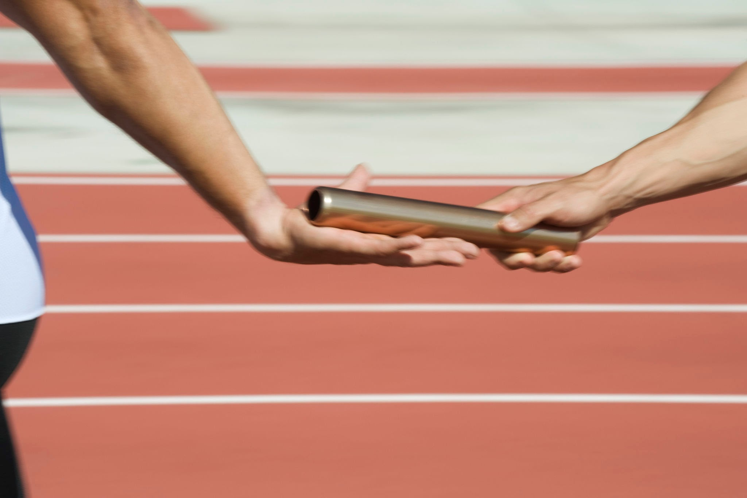
Deliver
Hand the iPhone over to next player

Slide 6
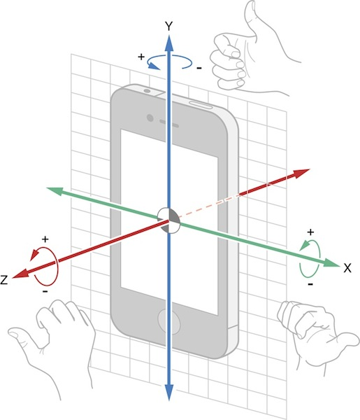
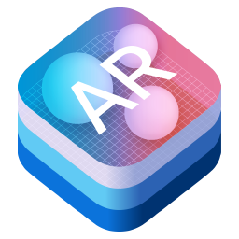

Frameworks
CoreMotion
Rotation
Gravity
Acceleration
Device orientation
ARKit or Camera
Light Sensor
AVFoundation
Plays sounds

Slide 7
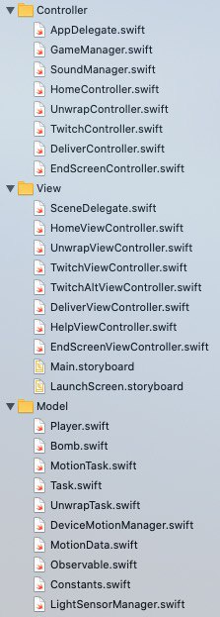
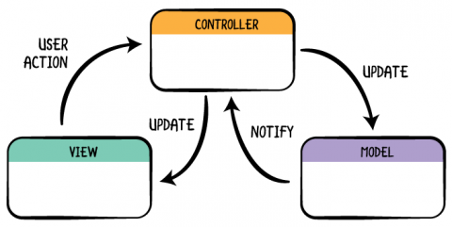
Interesting Encounters
Model-View-Controller (MVC) Hierarchy

Slide 8
Interesting Encounters
How and when to change the bomb stability (updateIntervals)
Explore different tresholds/boundaries for different sensors
Do not overlap with the UI
End a players turn with help of light sensor
Gravity value does not change, if one rotates around the gravity-axis
IOKit LightSensor

Slide 9
Light Sensor and IOKit
What we used:
ARKit
Reason: Easiest to implement
Ambient Light Sensor
Has no dedicated Framework
Therefore one can use one of the following:
AVFoundation(For vanella camera data)
ARKit (Camera data with Augmented Reality)
IOKit (Must use ObjectiveC)
IOKit
Not supported by Apple.
Develop will have problems publishing with this framework
Can only be used in Objective-C
Our Recommendation:
If you have Time:
AVFoundatation
For the masochists:
- IOKit

Slide 10
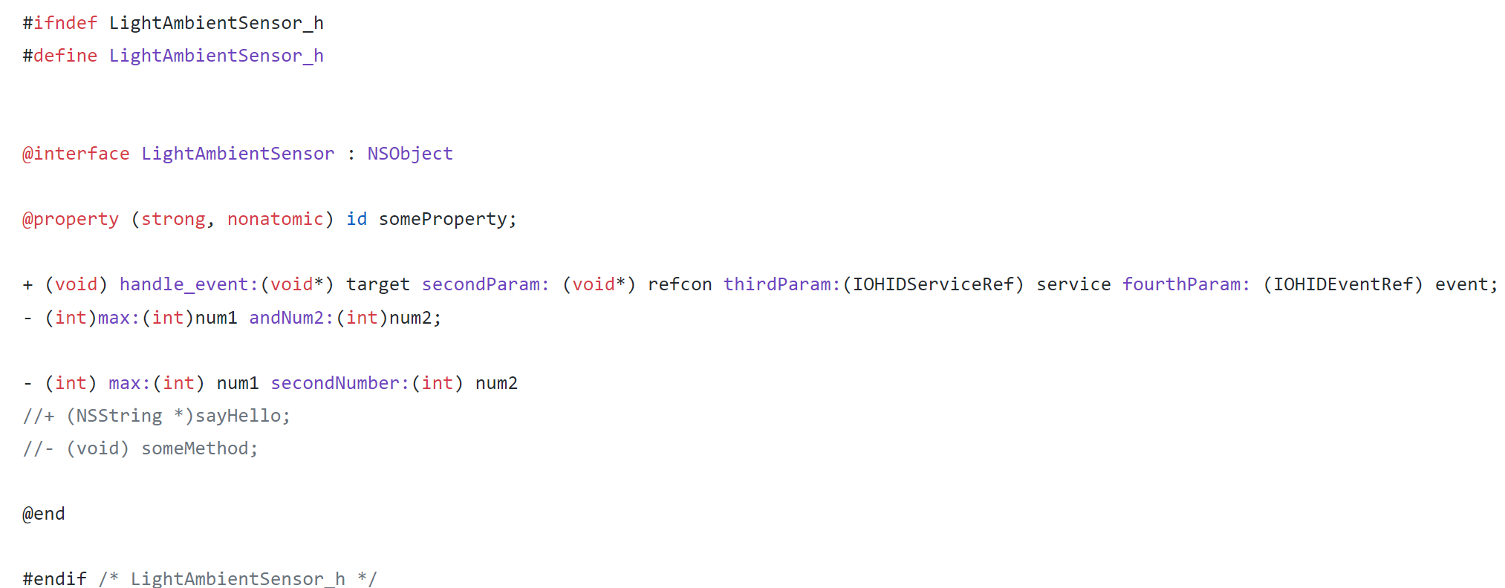
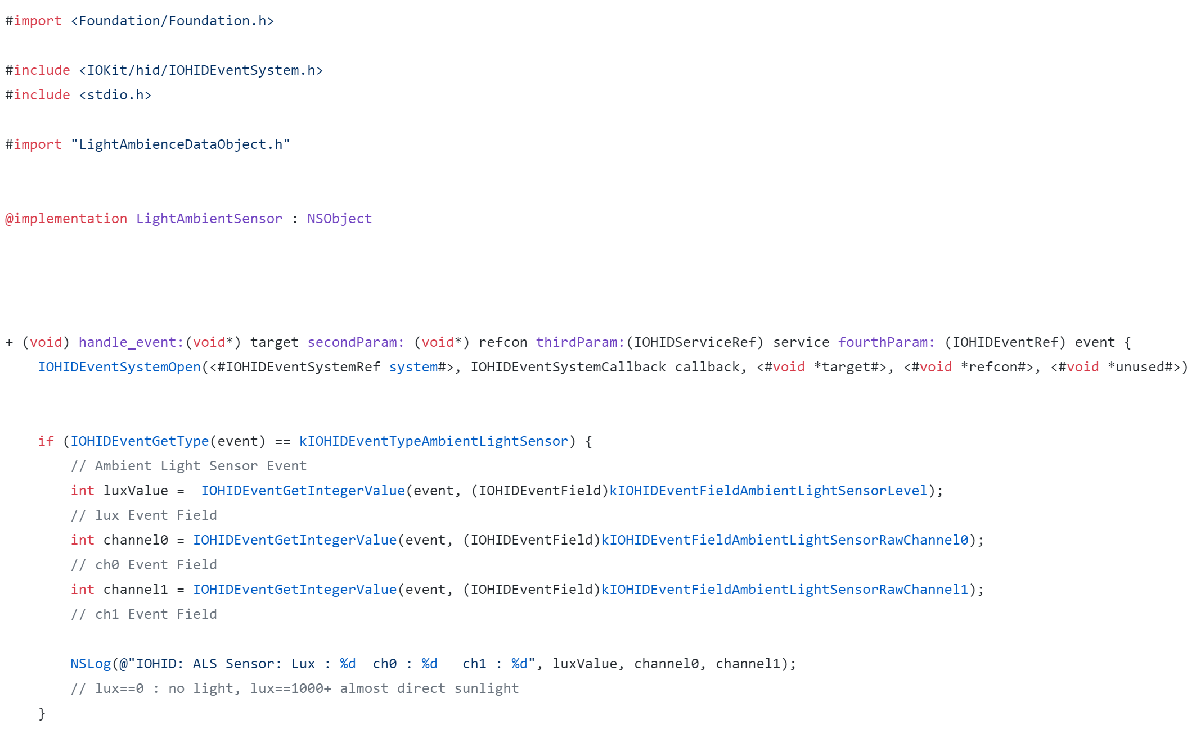
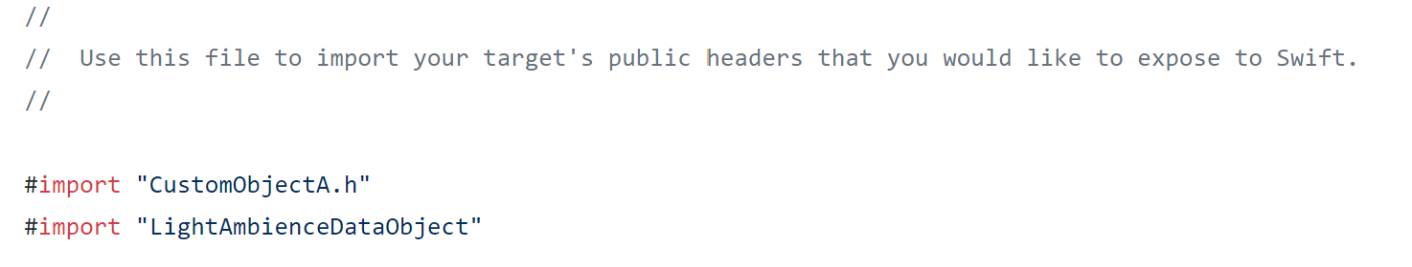
Objective-C to Swift
.h File used to initialise all variables the .m File be it a class or several functions just like in C++
.m File used to fill and give value to initialised values in .h File
Bridge Header – Used to connect Objective C code to Swift

Slide 11
.Swift file which implements the Objective-C logic
Objective-C to Swift
.m File used to fill and give value to initialised values in .h File
11

Slide 12
Live Demo

Slide 13
Thank you for your attention
Any Questions?

Slide 14
Additional ideas & changes
More tasks
Knock Rhythm with help of Sound recording
Count Shakes
Ball balance
Highscore for Players
Better unwrap Directions of Use
More Twitch Directions of Movement
Better UI
Structure of program
More Abstraction
More polymorphism

Slide 15
Problems
One iPhone and macbook
Github merge of main.storyboard
rbi-room is not always available
Start earlier (especially when researching the frameworks)

Slide 16
Code examples

Slide 17

Twitch Code
Update arrow direction and background color before the task starts
Use timer to sync the code and the UI

Slide 18
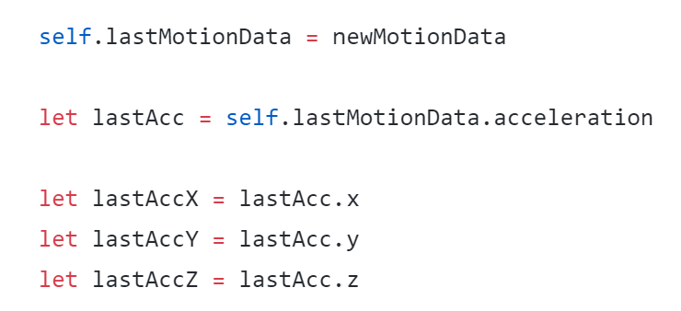
Twitch Code
This task uses the acceleratormeter to determine the moving direction of the phone

Slide 19
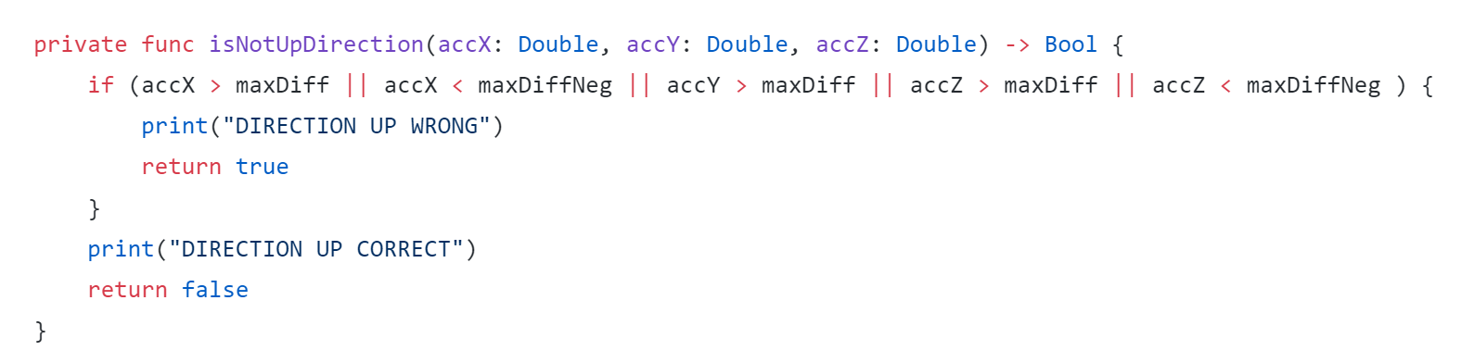
Twitch Code
Check the direction, take long to find out which value is correct

Slide 20
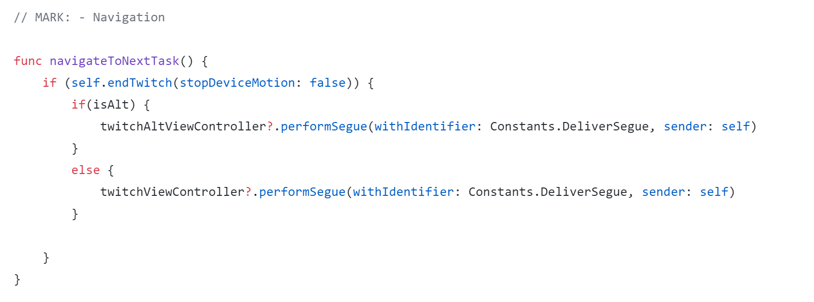
Twitch Code
Navigator

Slide 21
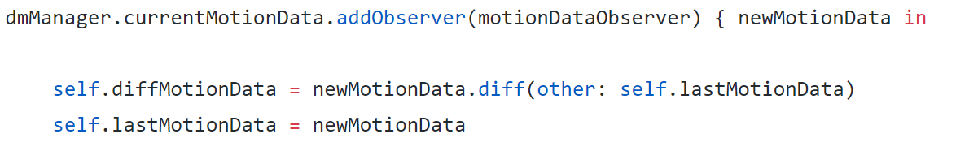
Deliver Code
Add observers

Slide 22
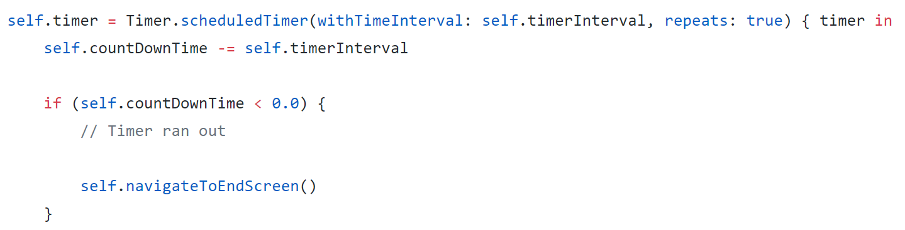
Deliver Code
Timer

Slide 23
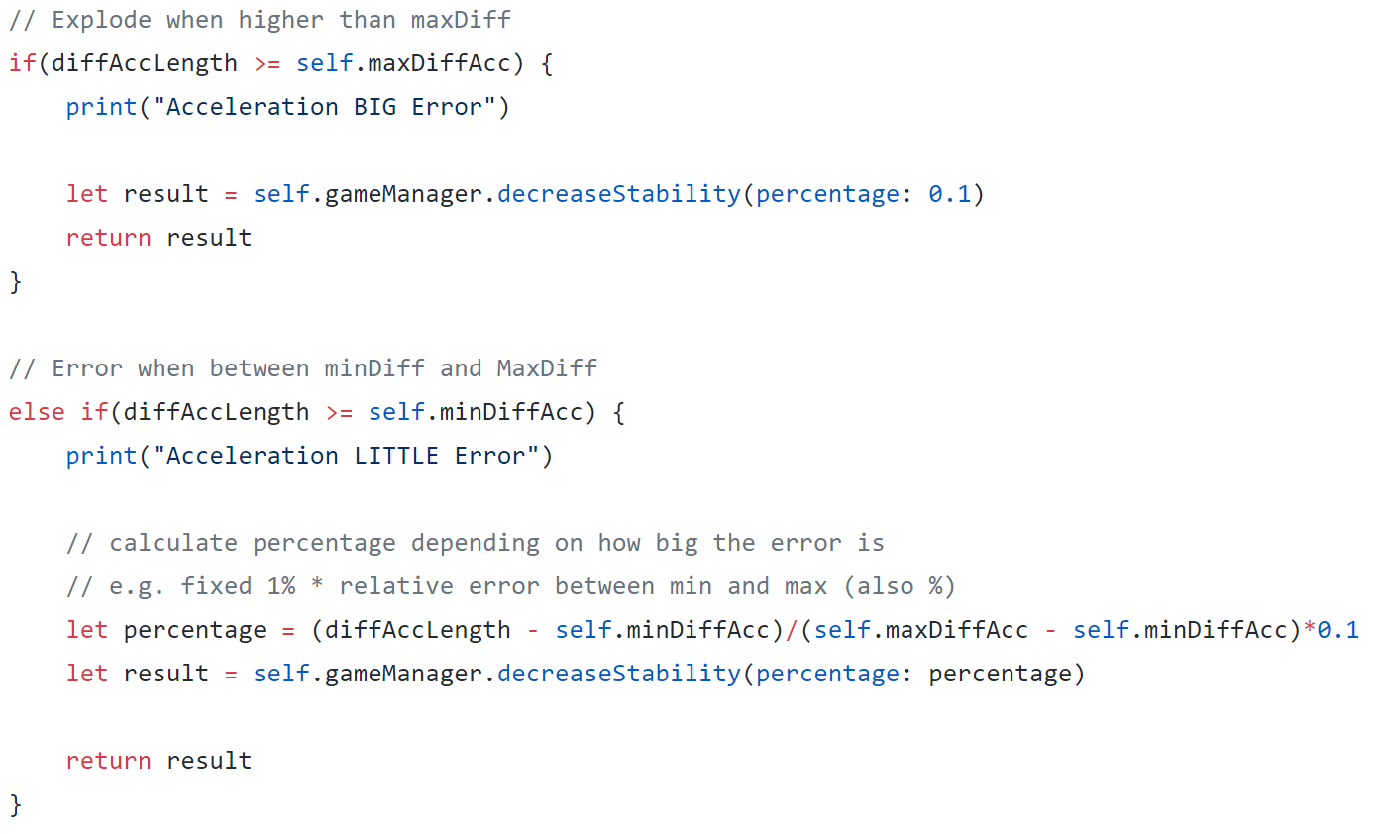
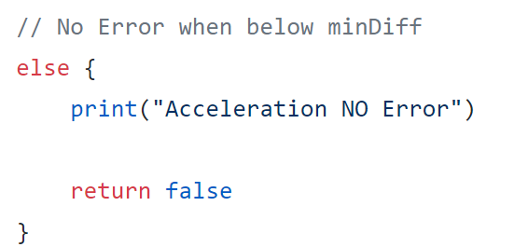
Deliver Code

Slide 24
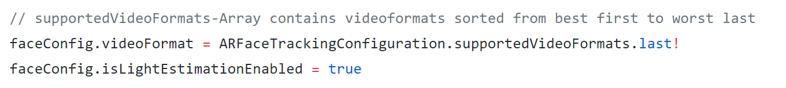
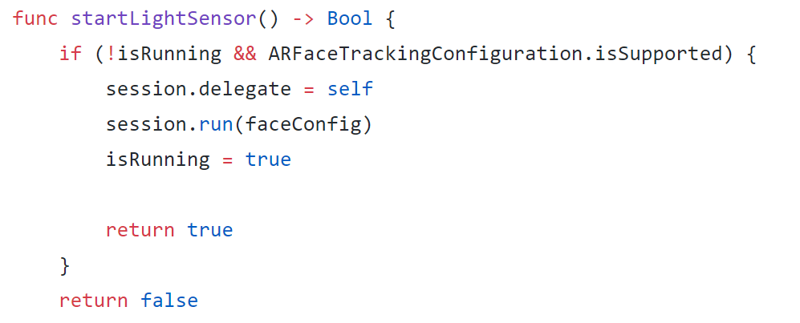
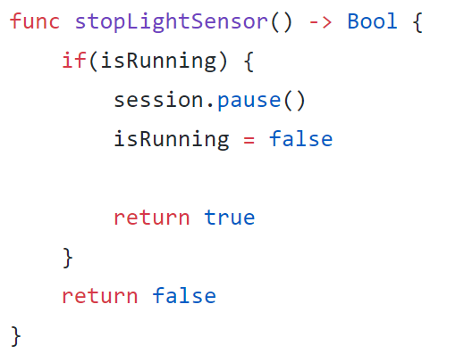
Light Sensor Code

Slide 25
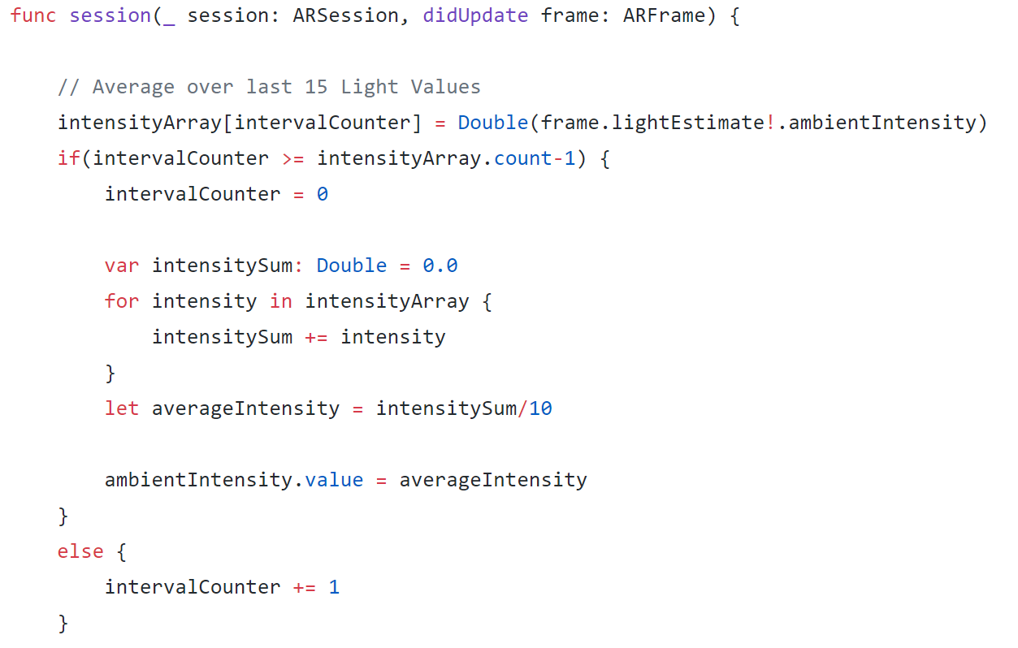
Light Sensor Code

Slide 26
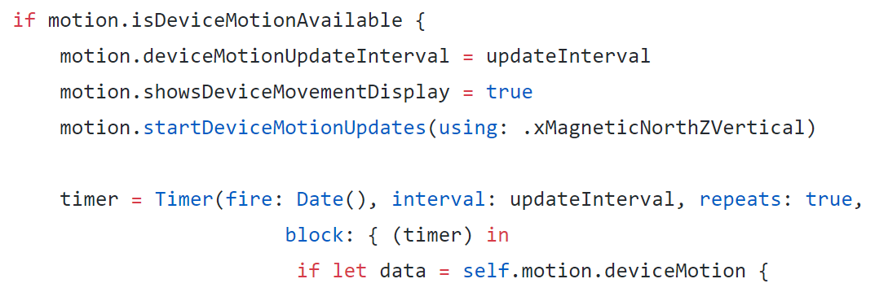
Device Motion Code
Use CMMotionManager

Slide 27

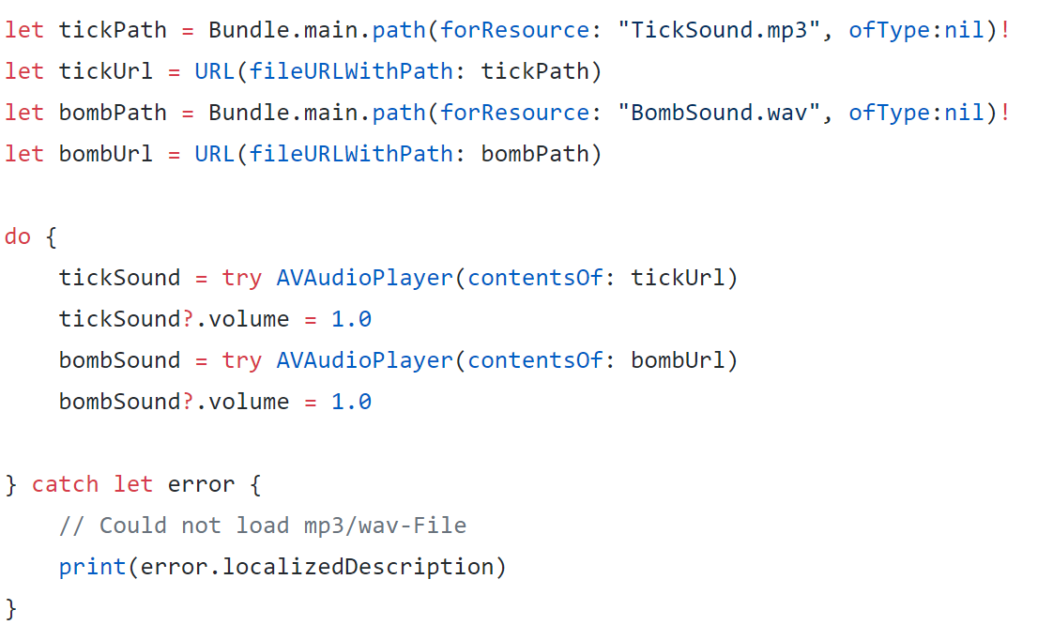
Sound Code

Slide 28
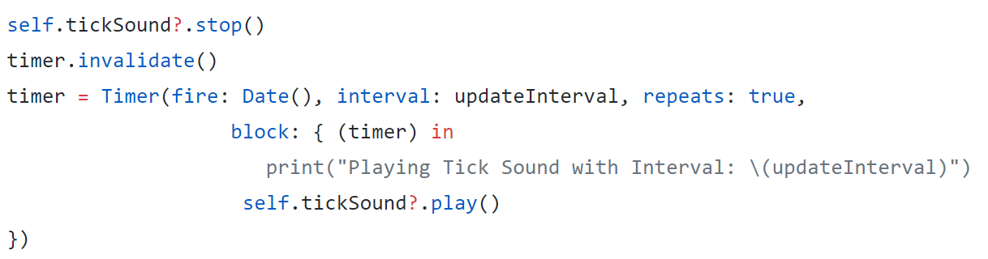
Sound Code

